Slide 1
GitGud v2.0 Github Workshop
A brief introduction to git, GitHub, and the importance of version control software.
Michael Flaherty
michaelwflaherty@me.com
Headline#9999
Notes:
Overview that we’re covering Git, GitHub, and why we need to learn it as up-and-coming software developers
A touch of my background, along with mentioning my contact info.

Slide 2
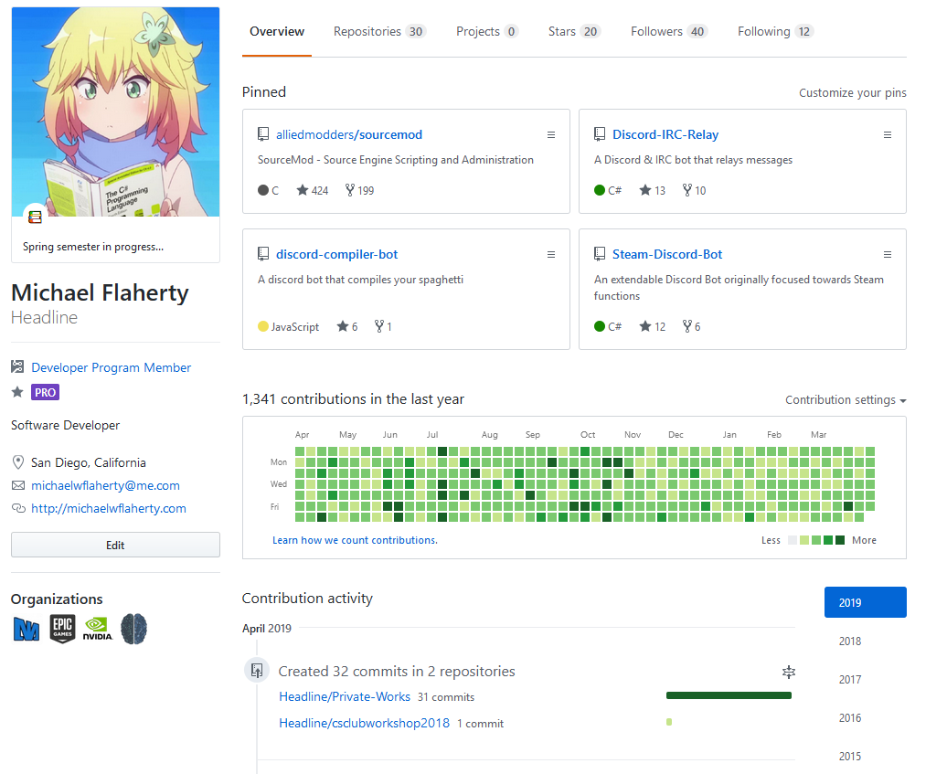
Notes:
Started using GitHub around 2015
Exposed me to open source communities where I really got a friendly environment to learn how to work with a team
Without GitHub, I wouldn’t have been able to grow as a software developer nearly as fast
Audience relevance
Our goal

Slide 3
The Problem
We need a flexible tool to allow collaboration and code sharing.
Imagine a team of developers passing around a flash drive:
Slow
Unable to tell who edited certain things
Only one person can edit at a time
Notes:
Software Developers need a way to download, edit, and re-upload code changes

Slide 4

don’t lose the flash drive

Slide 5
Advantages of git
History of authored changes
Easy distribution
Permissions system (allows public access)
Easy to collaborate with a team of developers

Slide 6
3 tracks to git excellence
1) Git CLI
Difficult without prior cli experience
2) GitHub Desktop
Easy introduction to the git universe
3) GitHub Web UI
Minimal effort required for quick changes
Extremely simple to use
Extremely limited in terms of actual git utility
Difficult without prior vcs experience
Faster to use
Most flexible in terms of options
Great preparation for other tools
Decent flexibility, perfect for beginners
Scientifically proven to prevent premature greying of hair
Notes:
Define cli and vcs
Ensure that everyone knows we’re picking the GitHub web UI path for our demonstration

Slide 7

What is github?
A web-based repository hosting service
A place for software developers to collaborate
A haven for open source software

Slide 8
STOP: Terminology TIME
Repository
Digital directory which holds your project
Commit
A virtual “checkpoint” which denotes a point in time
Branch
A way to isolate your work from others
Merge
How you pull your finished work into to main project
Notes:
Use the whiteboard to draw the way commit, branching, and merging works

Slide 9
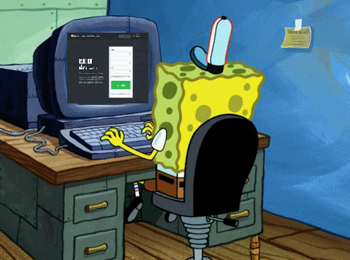
What do you need?
An email account
A computer

Slide 10
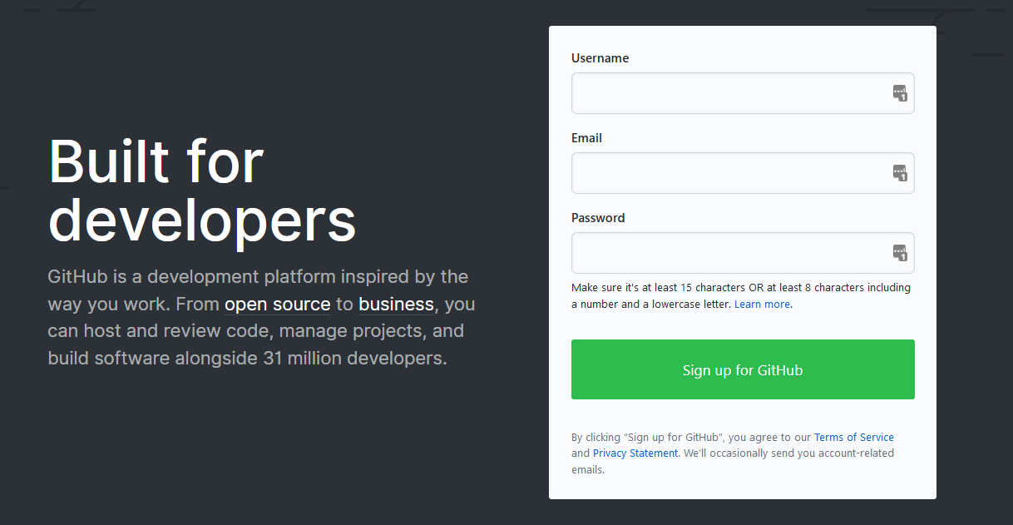
1st step: Registration

Slide 11
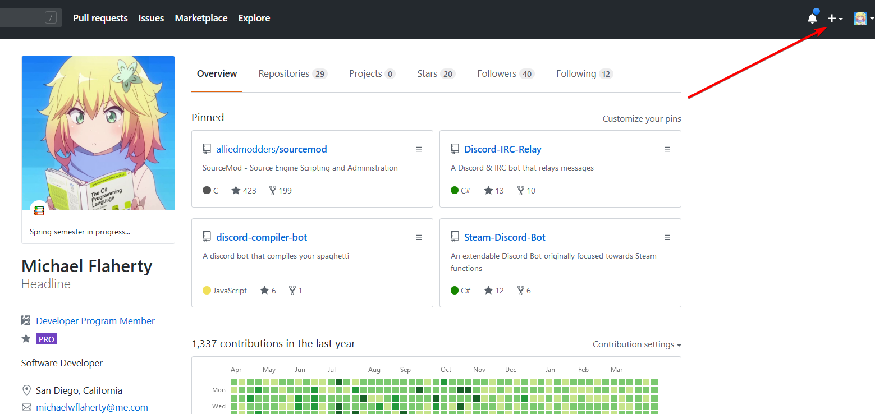
2nd Step: Creating a repository

Slide 12
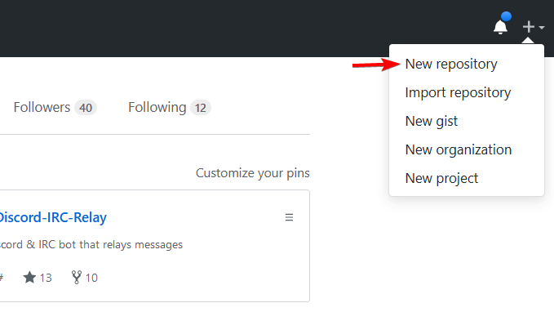
2nd Step: Creating a repository
Notes:
Define what a repository is,

Slide 13
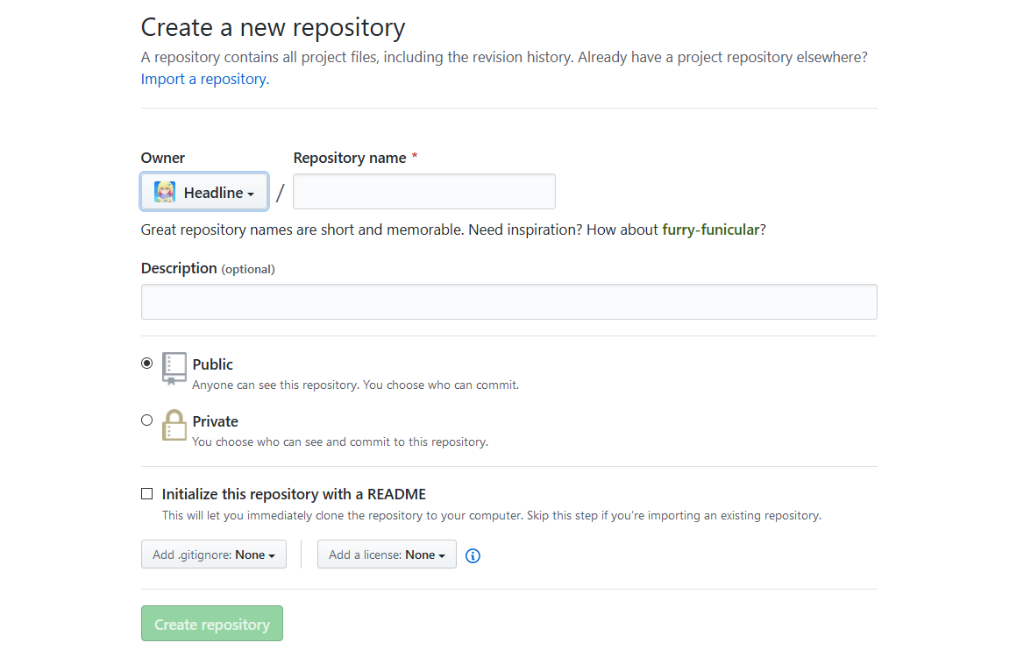
2nd Step: Creating a repository

Slide 14
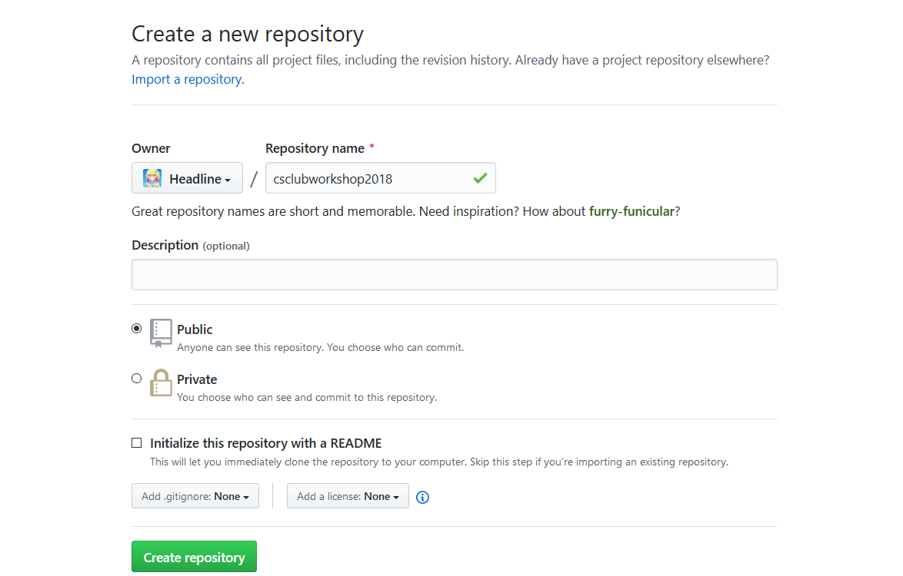
2nd Step: Creating a repository

Slide 15
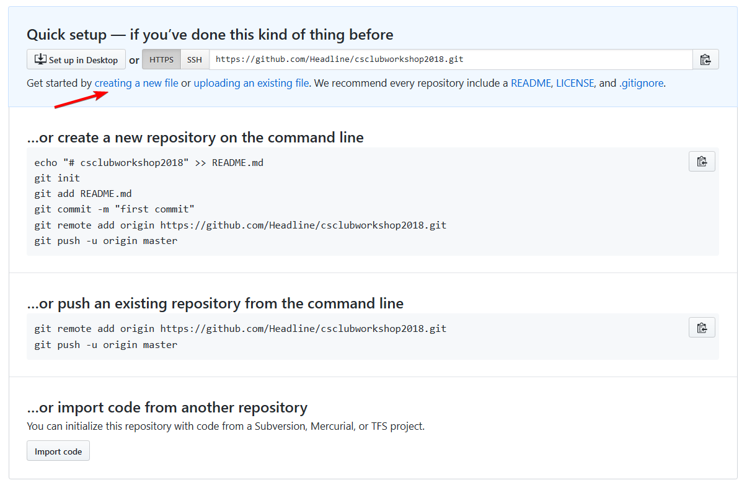
3nd Step: Creating a file

Slide 16
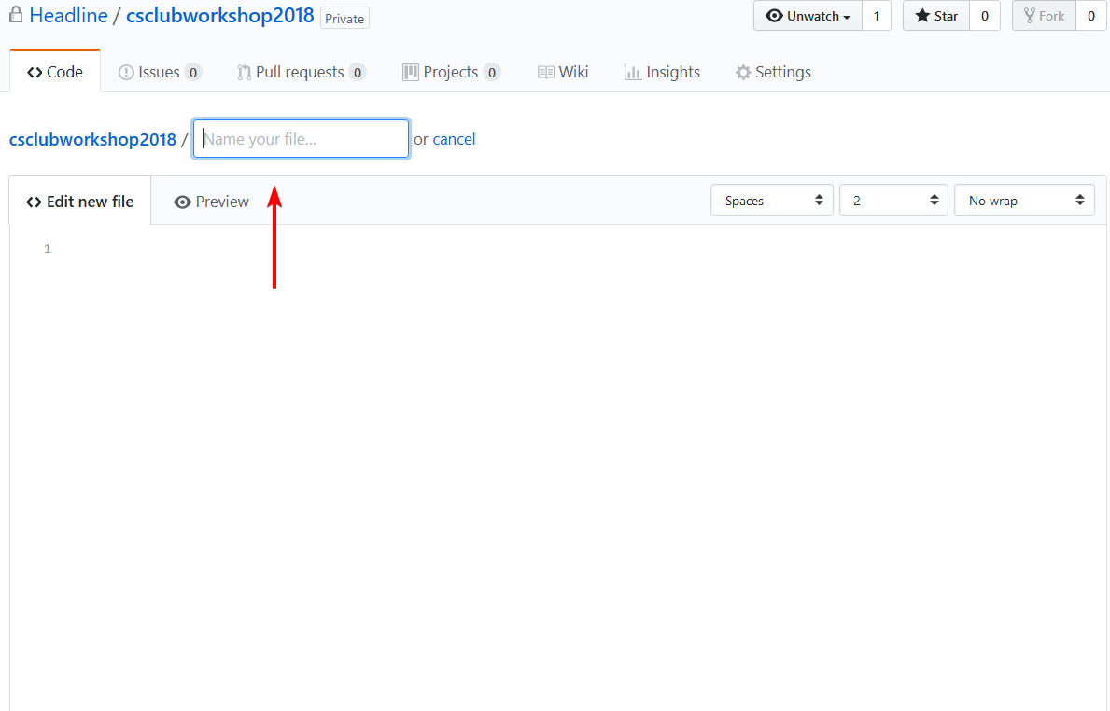
3nd Step: Creating a file

Slide 17
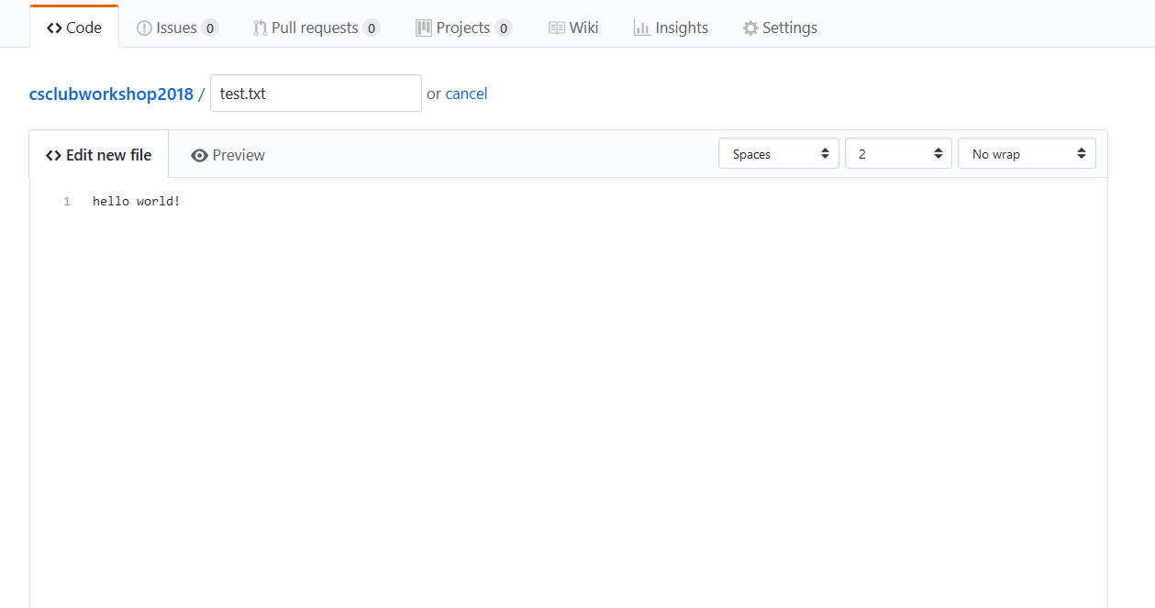
3nd Step: Creating a file

Slide 18
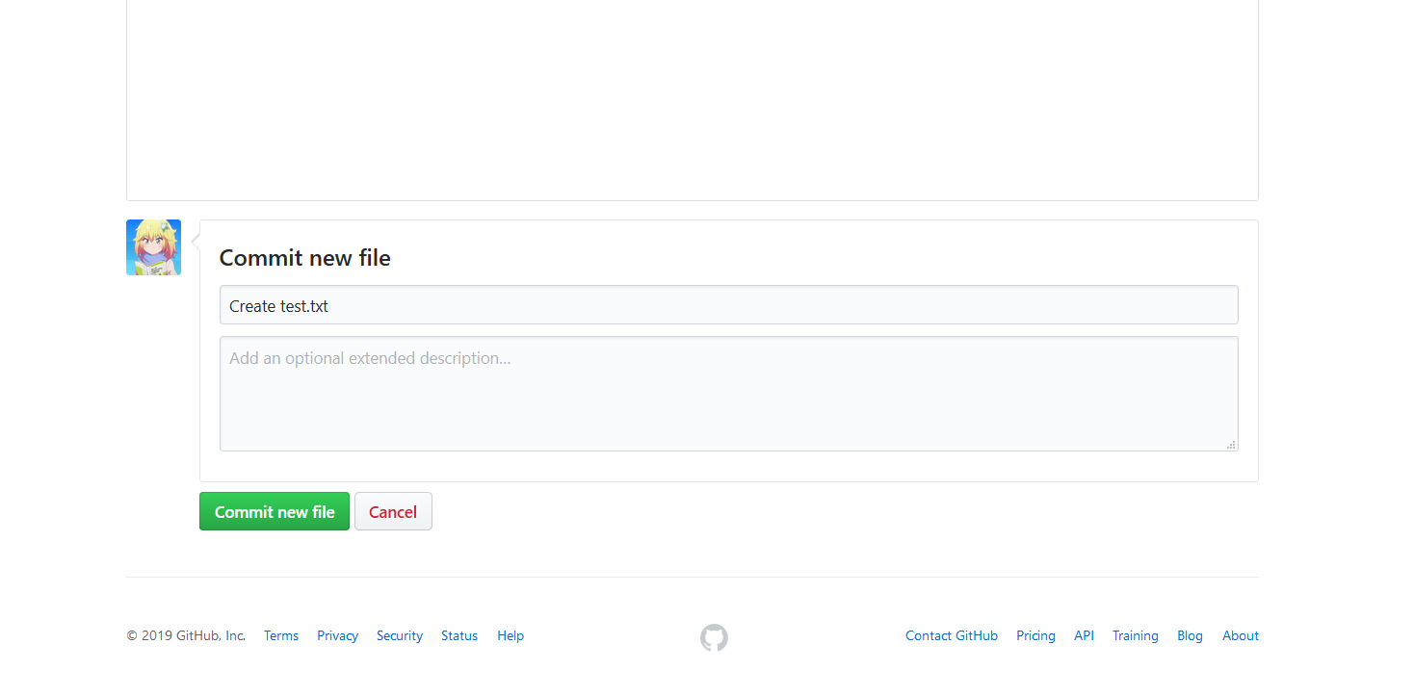
3nd Step: Creating a file

Slide 19
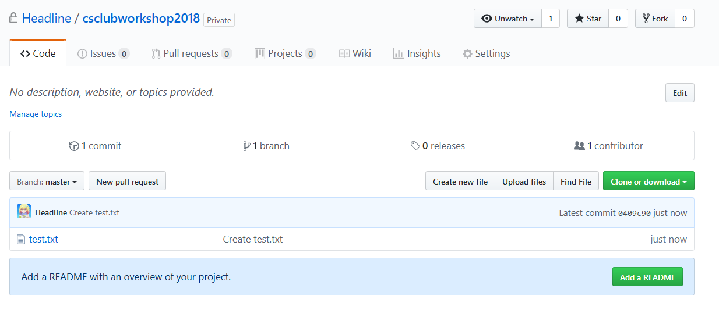
Your first repository!

Slide 20
Uploading projects to github
Useful for others to use or learn from
Self reflection
Portfolio of extra-curricular work
File storage
Notes:
Any questions before we move forward?

Slide 21
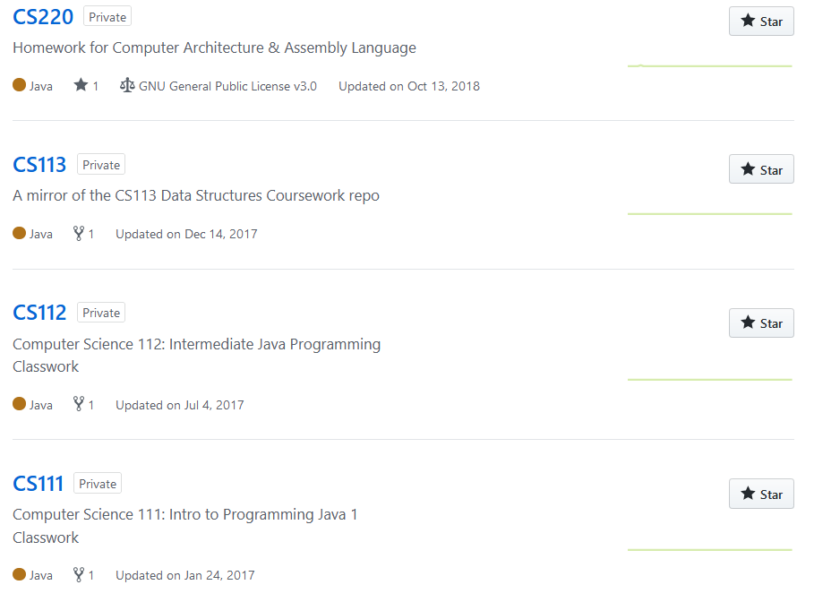
Private Repos on github

Slide 22

GitHub Student Dev. Pack
https://education.github.com/pack

Slide 23
Uploading projects to github

Slide 24
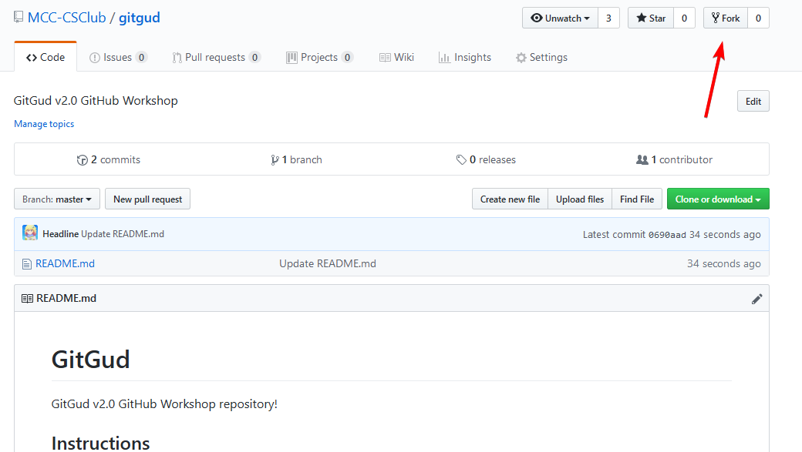
Final Activity
Notes:
A fork is a copy of a repository. Forking a repository allows you to freely experiment with changes without affecting the original project.

Slide 25
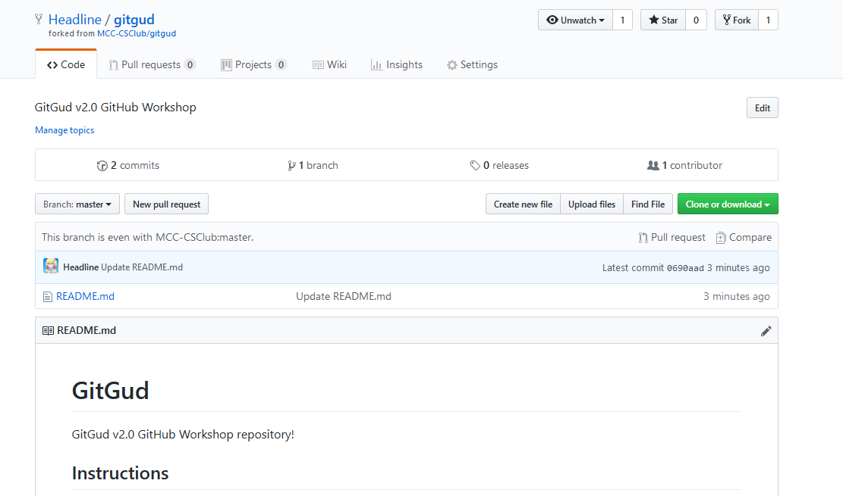
Final Activity Cont.

Slide 26
Final Activity Cont.

Slide 27
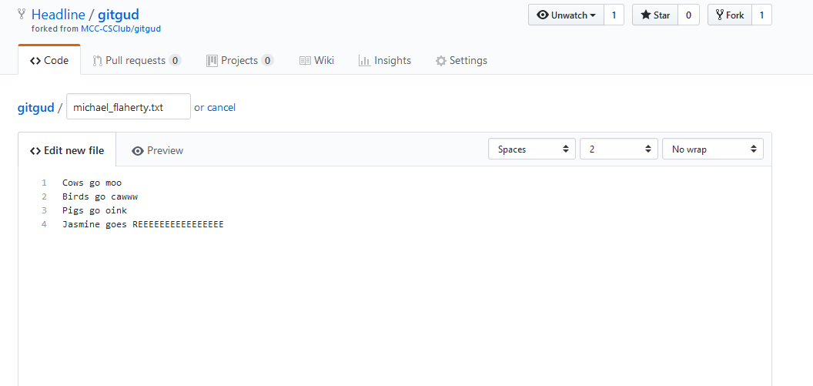
Final Activity Cont.

Slide 28
Final Activity Cont.

Slide 29
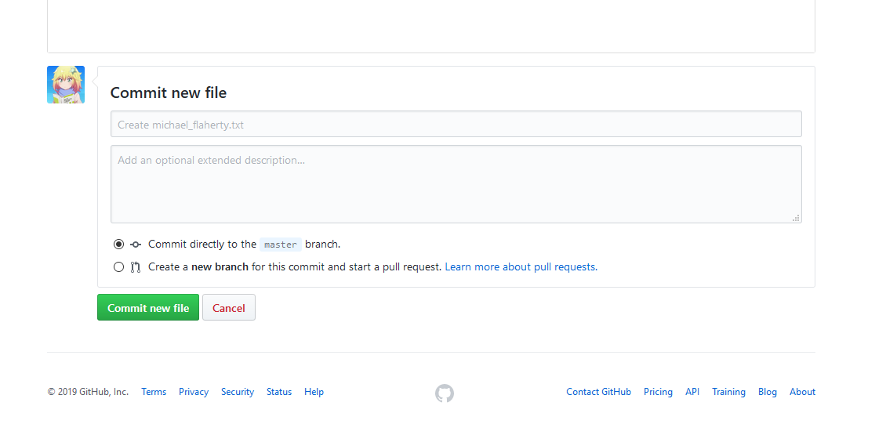
Final Activity Cont.

Slide 30
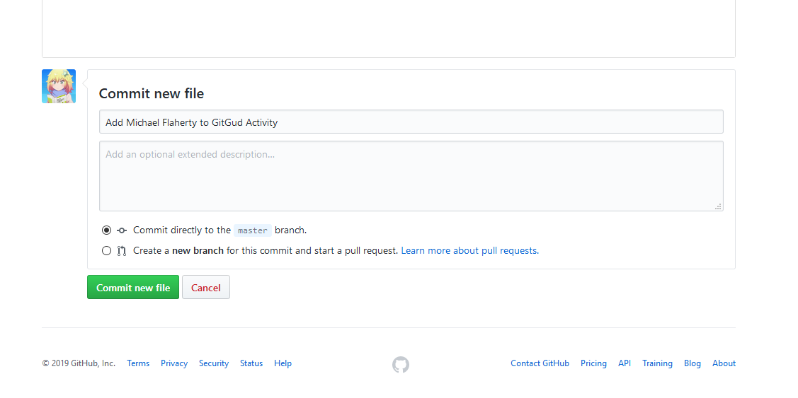
Final Activity Cont.

Slide 31
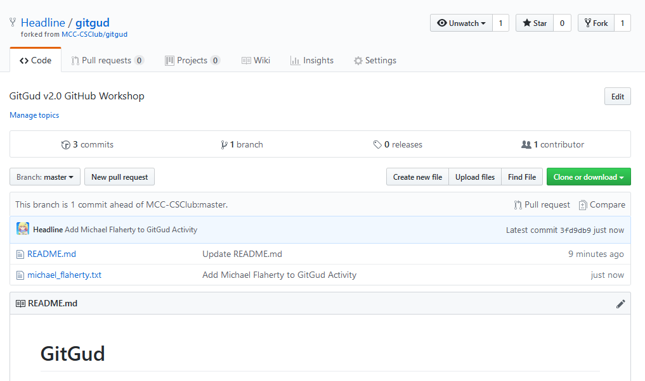
Final Activity Cont.

Slide 32
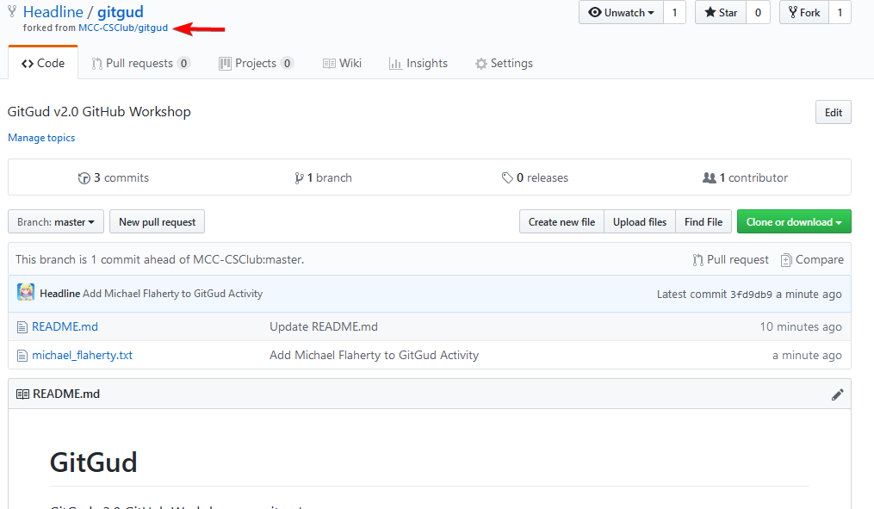
Final Activity Cont.

Slide 33
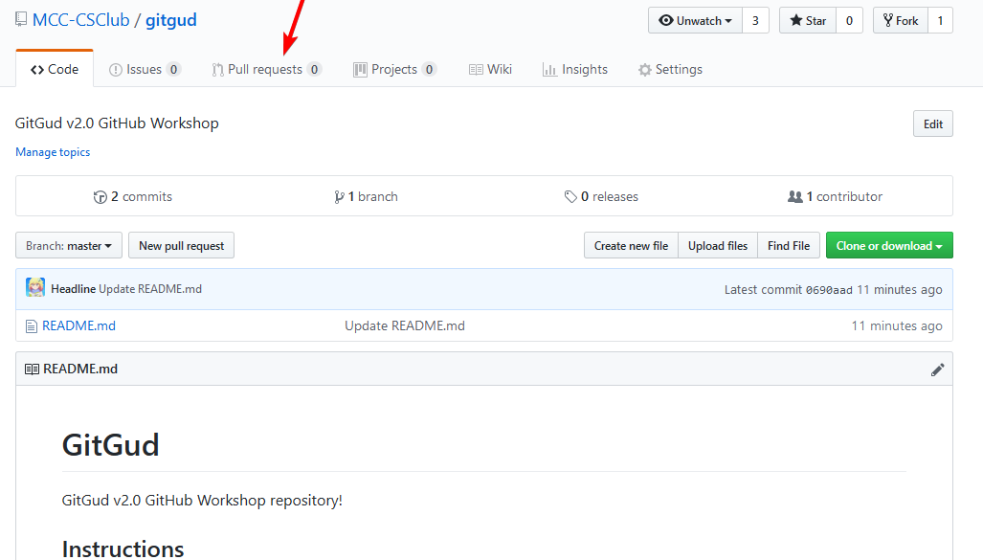
Final Activity Cont.

Slide 34
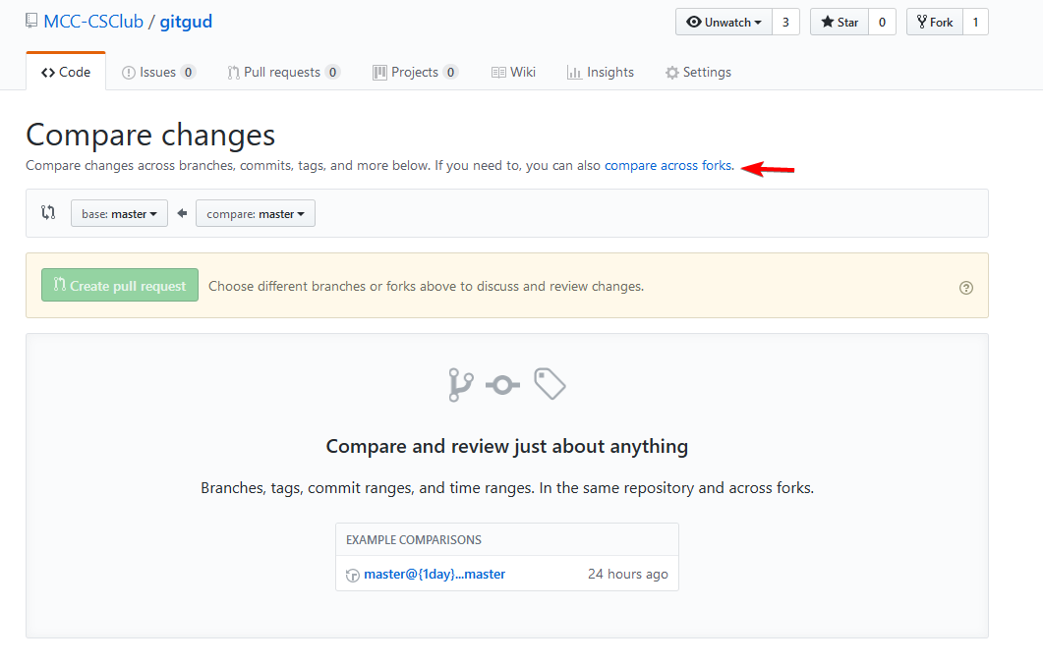
Final Activity Cont.

Slide 35
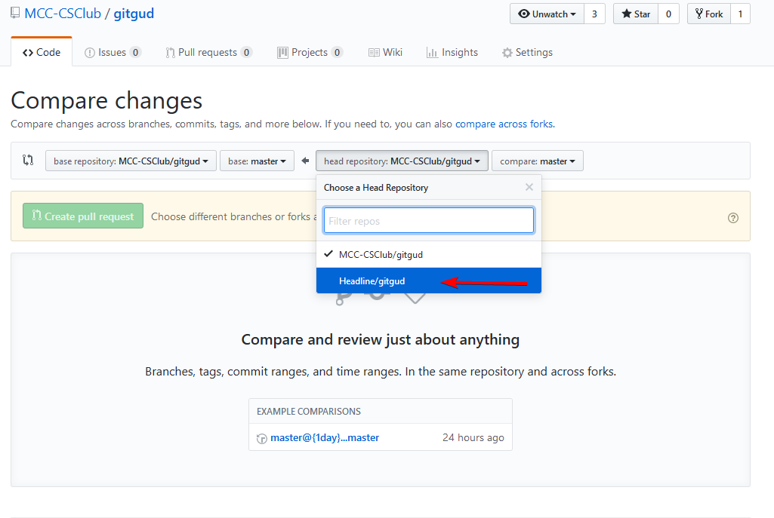
Final Activity Cont.

Slide 36
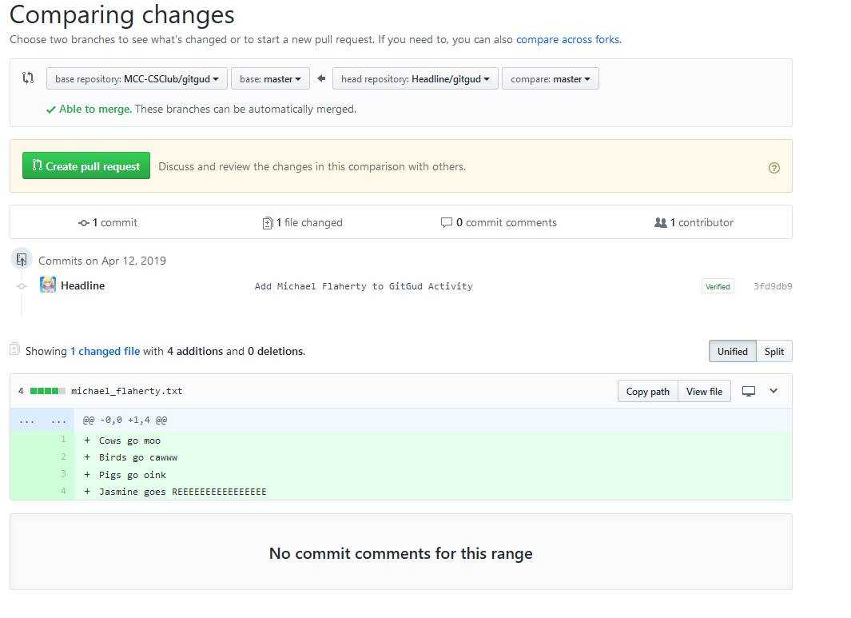
Final Activity Cont.

Slide 37
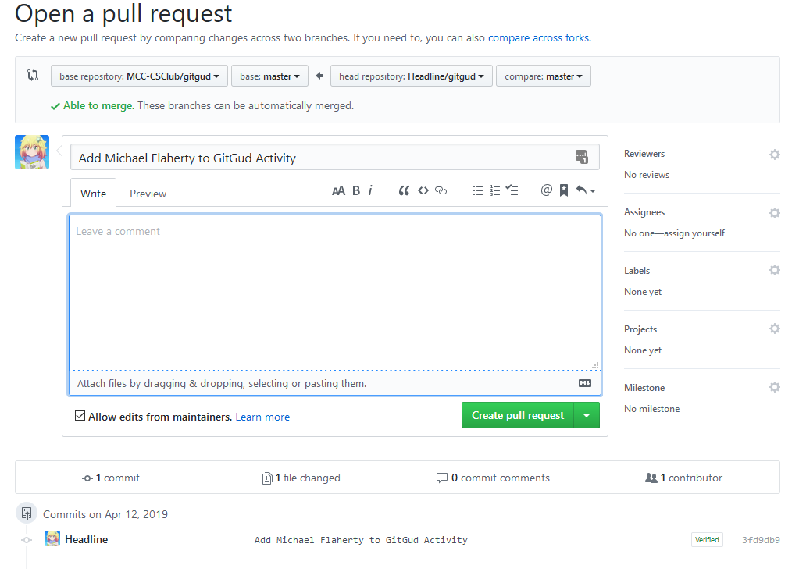
Final Activity Cont.
Notes:
Meaningful commit messages & comments

Slide 38
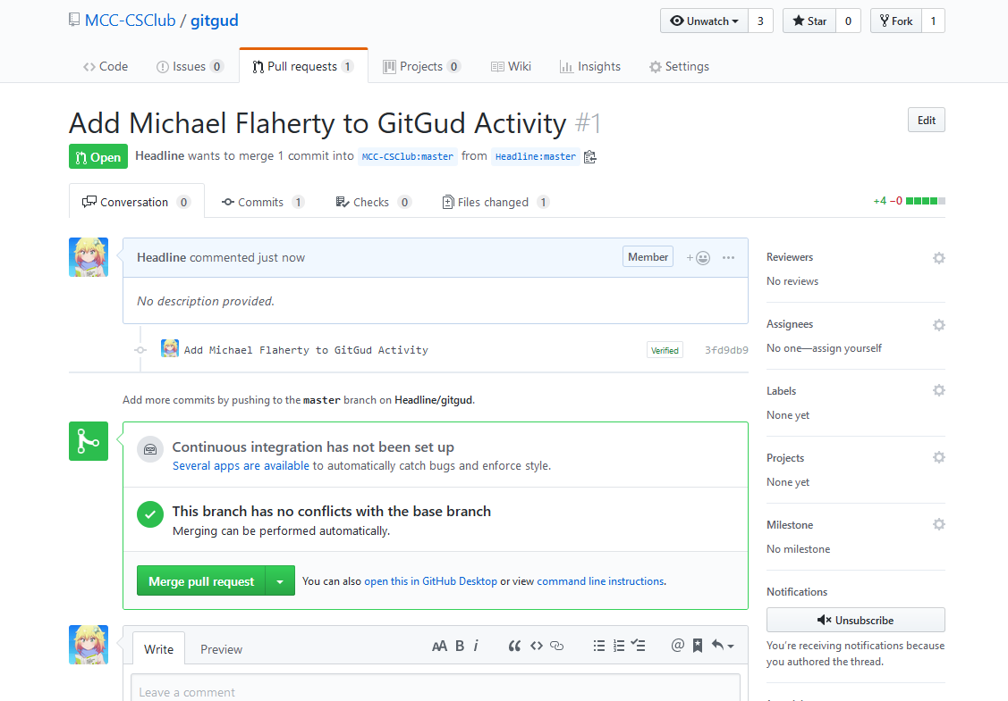
Final Activity Cont.
Notes:
I can merge, others can’t

Slide 39
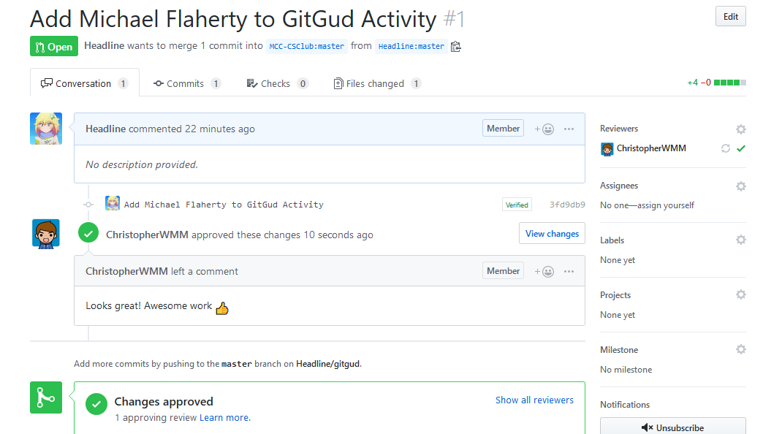
Final Activity Cont.
Notes:
I can merge, others can’t

Slide 40
You’re done!
Notes:
https://github.com/alliedmodders/sourcemod/pull/791

Slide 41
Notes:
Any Questions?

